Slide 1
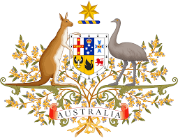
The Australian Constitution
Yr 7 Civics and Citizenship

Slide 2
Lesson Aims:
Review the topic of Federation
To understand what the purpose of Australia’s Constitution is
To understand the value of the Australian Constitution
Key vocab:
-Federation
-Constitution

Slide 3
Federation in Australia
A federation is the joining of the colonies to become one nation.
Colonies In 1860 there were six British colonies in Australia.
The main laws of the colonies were made by the British Parliament.

Slide 4
Federation – Behind the News
https://www.youtube.com/watch?v=ecB-Lpm_AZ0

Slide 5
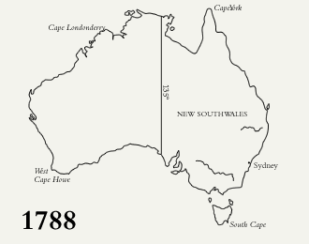

Slide 6
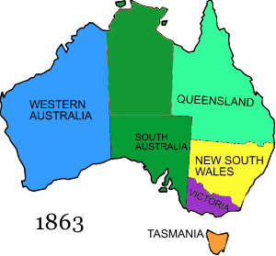

Slide 7
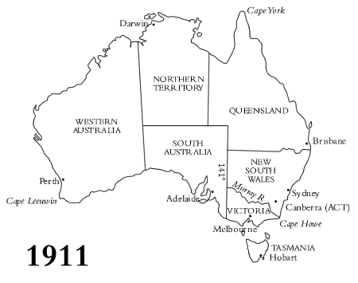

Slide 8
Discuss the BtN Federation story with another student and record the main points of your discussion.
Before Federation, Australia was divided into six separate ______________. | Which other country might have been part of Australia?
Who was Henry Parkes? | What was his famous speech about?
Why were initial attempts to become a Federation rejected? | What role did Alfred Deakin play in Australia becoming a Federation?
In what year did Australia become a nation? | Who was Australia’s first Prime Minister?
How did Federation impact on Indigenous people and Chinese migrants?

Slide 9

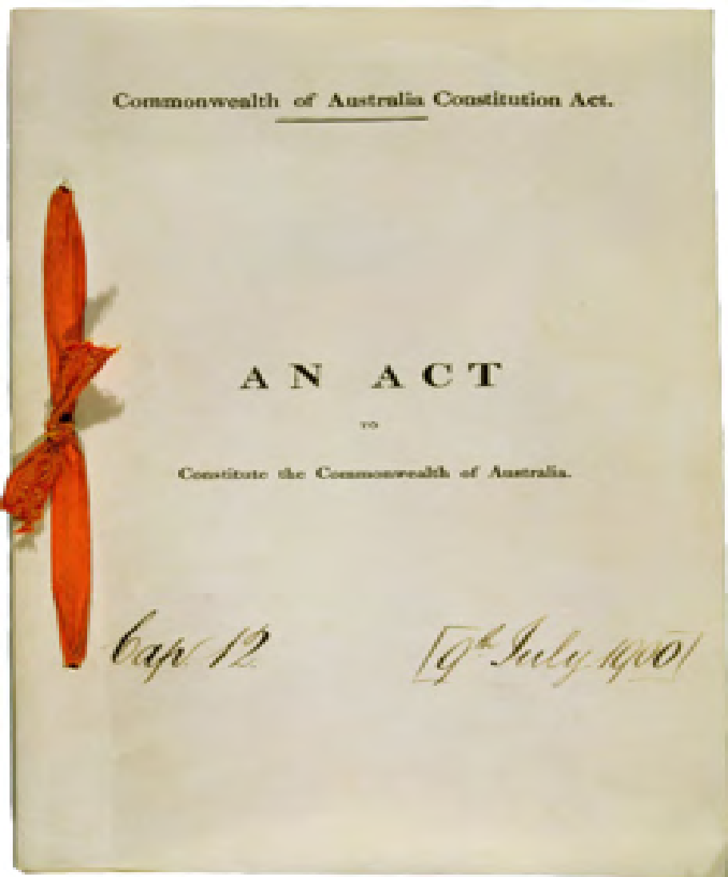
The Australian Constitution- History
The Australian Constitution is the set of rules by which Australia is run.
It came into effect on 1 January 1901 (Federation), establishing the Commonwealth of Australia.
Before this, Australia was not a nation and each of the colonies had their own separate rules/laws.
The Constitution was written to explain how the new nation would operate and what the mean features of its government would be.

Slide 10
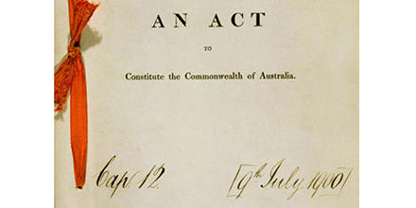
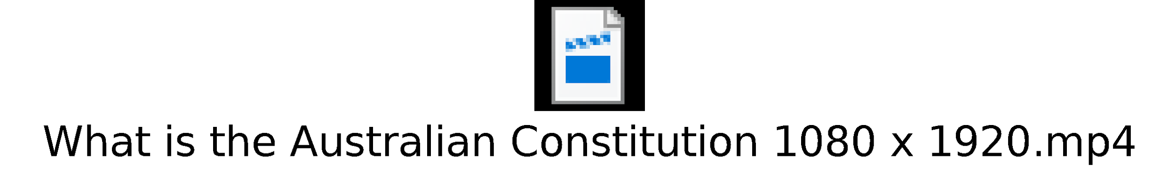

The Australian Constitution- Videos
A written document that set out the rules by which our country is governed.
https://www.abc.net.au/btn/classroom/constitution/10529046

Slide 11
The Australian Constitution- Value
It’s important to have a written Constitution for many reasons:
It gives a set of laws that can be followed consistently (means that people can’t make things up as they go along)
It describes the role of the government and how it should be structured so that all decisions are made on behalf of the whole country
It defines how power should be divided (so that one person doesn’t have all of the power)
It allows citizens to read and understand the structures and laws of our country
It creates a national identity separate to Britain. Some call it our ‘Birth Certificate’

Slide 12
Constitution- Purpose and Features
The document is divided into 8 sections. Its purposes are:
Establishing the government of the Commonwealth of Australia as a democracy
• Outlines how the government should be structured
• Making sure the people in government have been chosen by the people (through elections)
• Allow anyone to run for government if they want to
• Stating our rights and responsibilities we have as Australian citizens
• Outlines the roles and duties of state governments
• Ensuring all people obey the laws
• The constitution can be changed through a referendum. This requires a Yes/No vote from the majority of Australians. This is because laws that were important to us in the past might not be important or relevant to us now.

Slide 13
What is a referendum?
The Australian Constitution can only be changed with the approval of the Australian people. A proposed change must be approved by the Parliament and then be put to Australians in a referendum. All Australian citizens on the electoral roll then vote ‘yes’ or ‘no’ to the proposed change.
A famous referendum was successful in 1967 that allowed for Aboriginal people to be counted as Australians within the constitution. This was a significant event for all Australians and is regarded as a symbolic step in the indigenous rights movement. We will learn more about this later in the term!

Slide 14
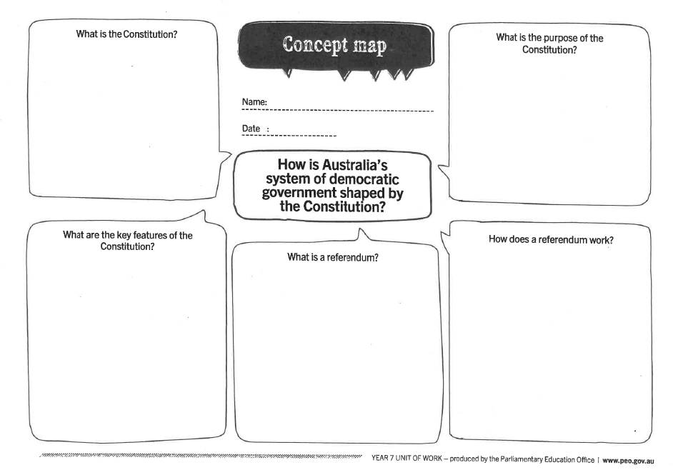

Slide 15
Activities
Comprehension Questions
1. What is the Australian Constitution?
2. What is a rule? Think of an example of a rule that we have at school.
3. Add the following definitions to your glossary/word wall: federation, constitution
4. What is the main purpose of the constitution?
5. Describe five key features of the constitution.
Thinking Questions
1. How old is the Australian Constitution?
2. Why do you think some people call the Australian Constitution our ‘birth certificate’?
3. What do you think is the most important thing about the Australian Constitution?
4. Do you think there are any problems with the Constitution being written so long ago? What are they?

Slide 16
Research and Extension
1. Test your knowledge with a constitution quiz! https://peo.gov.au/teach-our-parliament/education-resources/quizzes/australian-constitution/
2. Watch this clip about the Constitution. Outline the issues faced by Aboriginal and Torres Strait Islander people before and after the 1967 referendum. https://www.abc.net.au/btn/classroom/constitution/10529046
3. Should the constitution be changed to recognise Aboriginal and Torres Strait Islander people? Explain your answer.

Slide 17
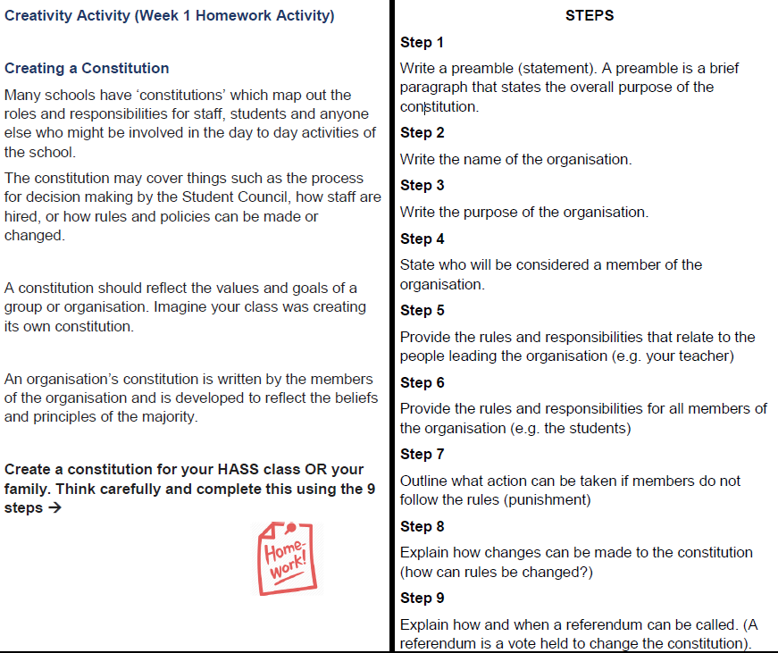

Slide 18
Cloze Activity
The Australian ___________________provides the________________ for how Australia is run. Described as the birth certificate of the nation, the Constitution is made up of _________chapters and ___________ sections. The Constitution united the_________ British colonies to form a ________________________. The Constitution describes the powers of ______________ and__________________ parliaments. Sections _________and_________ outline the law-making powers of_____________________ Parliament.
Constitution eight six nation 128 rules state commonwealth 51 52 federal

